Slide 1
Optiver Realized Volatility Prediction
Chensheng Ma, Deyu Li, Zeyang Zhou

Slide 2
Agenda
1.Background
2.Descriptions: Features, Visualization, Statistics
3.Model selection
4.Evaluation metric
5.Problems encountered

Slide 3
Background
It is a brand new posted kaggle competition.
Volatility is one of the most prominent terms you’ll hear on any trading floor – and for good reason. In financial markets, volatility captures the amount of fluctuation in prices. High volatility is associated to periods of market turbulence and to large price swings, while low volatility describes more calm and quiet markets. For trading firms like Optiver, accurately predicting volatility is essential for the trading of options, whose price is directly related to the volatility of the underlying product.

Slide 4
2. Description of Features
stock_id - ID code for the stock. Not all stock IDs exist in every time bucket. Parquet coerces this column to the categorical data type when loaded.
time_id - ID code for the time bucket. Time IDs are not necessarily sequential but are consistent across all stocks.
seconds_in_bucket - Number of seconds from the start of the bucket, always starting from 0.
bid_price[1/2] - Normalized prices of the most/second most competitive buy level.
ask_price[1/2] - Normalized prices of the most/second most competitive sell level.
bid_size[1/2] - The number of shares on the most/second most competitive buy level.
ask_size[1/2] - The number of shares on the most/second most competitive sell level.
Notes:
112 stock id

Slide 5
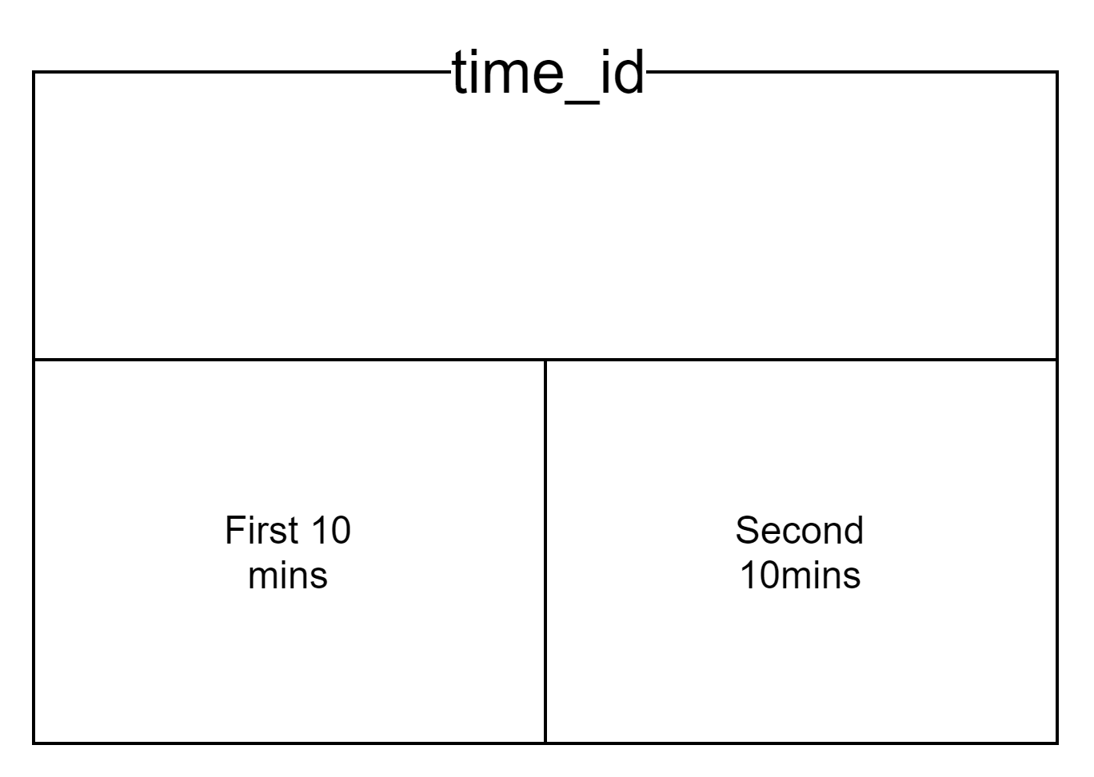
Time window

Slide 6
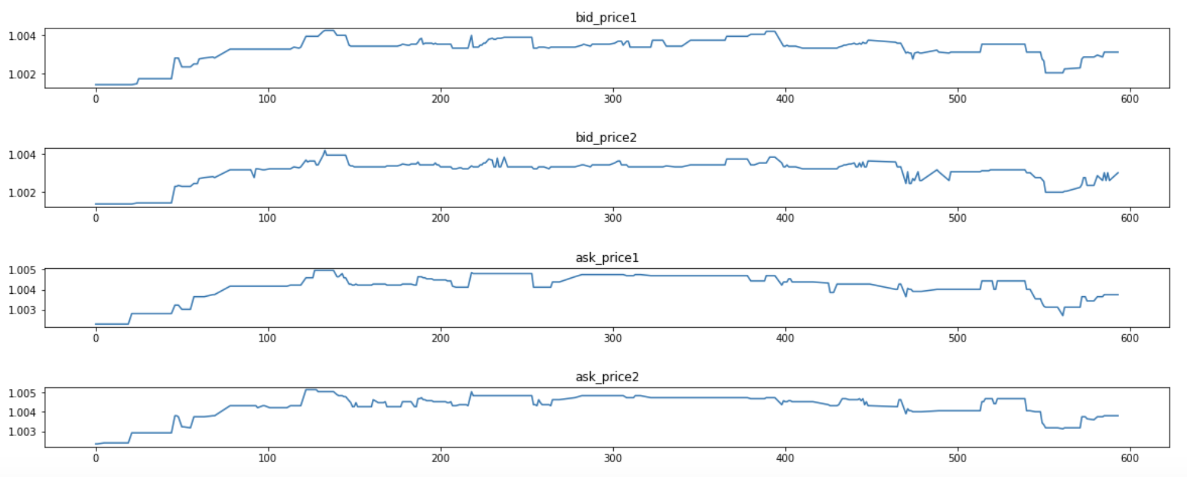
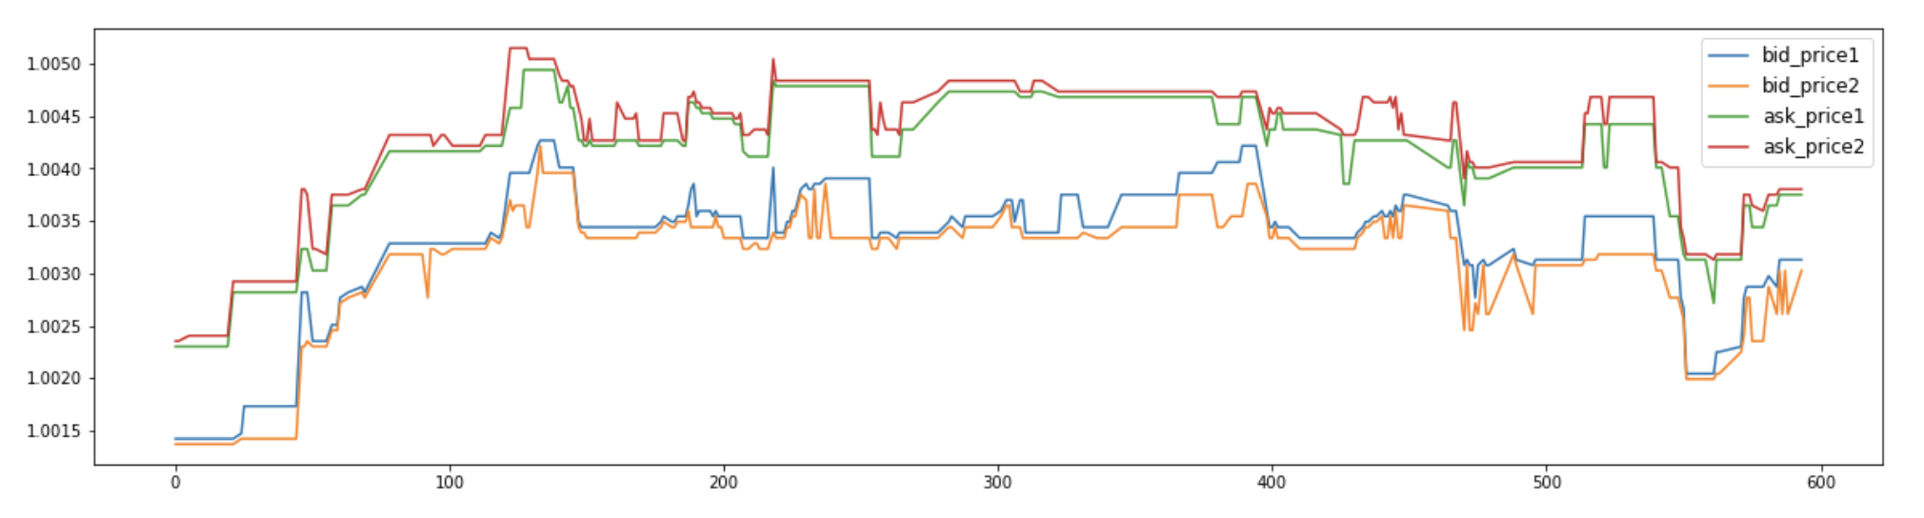
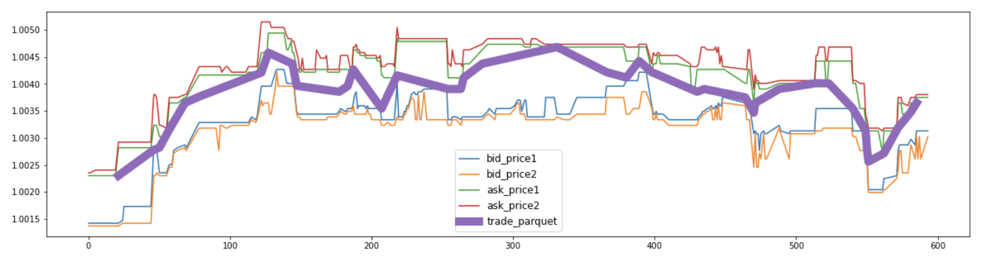
2. Visualization
Stock_id = 0
Time_id = 5

Slide 7
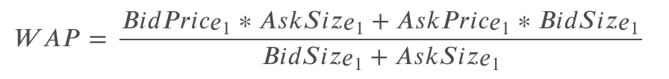
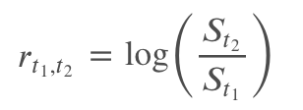
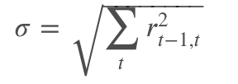
2. Descriptive Statistics
Weighted averaged price:
Log returns:
Realized volatility(Target):
Introduction of Financial Concept: https://www.kaggle.com/jiashenliu/introduction-to-financial-concepts-and-data?scriptVersionId=67183666#Competition-data

Slide 8
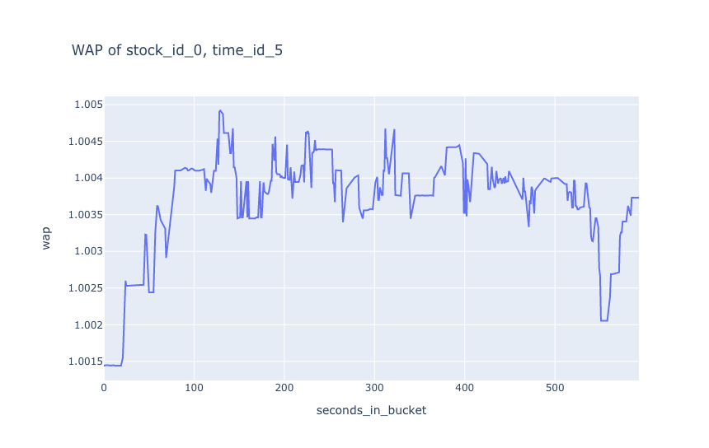
The WAP of the stock:
Notes:
In this competition we used weighted averaged price, or WAP, to calculate the instantaneous stock valuation and calculate realized volatility as our target.

Slide 9
3. Model Selection
Simple linear model
Gradient-boosted trees (GBTs)

Slide 10
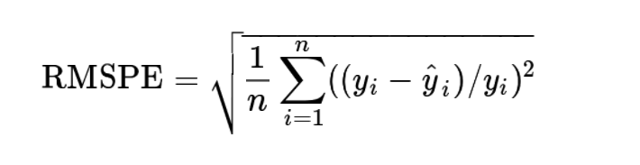
4. Evaluation metric
Submissions are evaluated using the root mean square percentage error, defined as:

Slide 11
Example
Performance of the simple linear model prediction:
R2 score: 0.612,
R2adj: 0.6104051746861203
RMSPE: 0.454
coefficient
ask_price1 | 1.6909
wap | 1.3052
bid_price2 | 0.5775
ask_price2 | 0.0980
log_return | 0.0286
time_id | -0.0000
seconds_in_bucket | 0.0000
bid_size1 | -0.0000
bid_size2 | 0.0000
ask_size2 | -0.0000
stock_id | 0.0000
bid_price1 | -3.7194

Slide 12

Top 10

Slide 13
5. Problems encountered
How to split time series data into three dataset?
How to derive more features based on original dataset?
How to manage our memory under limited local RAM?
How to do advanced feature engineering?

Slide 14
6. Conclusion
Thanks for listening!

Slide 15
References
Introduction to financial concepts and data. (n.d.). Retrieved November 1, 2021, from
https://kaggle.com/jiashenliu/introduction-to-financial-concepts-and-data
Optiver Realized Volatility Prediction. (n.d.). Retrieved November 1, 2021, from
https://kaggle.com/c/optiver-realized-volatility-prediction
Brownlee, J. (2016, December 18). How To Backtest Machine Learning Models for Time Series Forecasting. Machine Learning Mastery. https://machinelearningmastery.com/backtest-machine-learning-models-time-series-forecasting/
Linear Regression #3. (n.d.). Retrieved November 1, 2021, from
https://kaggle.com/dnging/linear-regression-3

